Slide 1

INDG6002
Week 1 – Workshop
Orientation

Slide 2
Acknowledgment of Country
An Acknowledgement of Country is a demonstration of respect for the Traditional Caretakers of the land on which a meeting or event is being held. It is a recognition of the continuing relationship between Aboriginal and Torres Strait Islander peoples and their Country, acknowledging their continuing connections to land, sea, and community.

Slide 3


This week
Welcome
Our Team
Gnibi Elders Principles
Outline of Unit
Assessments
Questions

Slide 4
Team
Dr Ros Sawtell – Lecturer
Dr Coral Jeffries – Lecturer
Dr Barb Kinder - Lecturer
Kirra Louise – Lecturer
Dr Darlene Rotumah – (UA)
Darlene.Rotumah@scu.edu.au

Slide 5
Gnibi Elders Principles
Indigenous Knowledge is a relevant, ethical, intelligent, effective and a useful way of knowing.
Indigenous peoples are active, able and worthy peoples.
The truth about our histories and value of Indigenous ways are determined by us, we carry this knowledge.
Elders hold our Aboriginal Spirituality and our culture close. We choose what is open and shared and what will be closed. Aboriginal spirituality is the basis for life Indigenous Education and Cultural Competency, it infuses everything.
Our knowledge is relational. Our principles are the basis for SCU to establish and sustain an active informed and respectful relationship with Indigenous Elders who will give considered collective input. The continuance of this relationship through the Elders group is essential.
Culture is sacred to us. We are and own this living culture. We do not need a ‘book’. We share with you so that you can learn how to listen and hear what we say.
Identity is based upon things [inside] beneath the surface. Empowered, individual, affirmed identity is the basis of positive, productive, healthy and non-destructive lives - opportunities to engage and build knowledge builds [strong mob] through [inside learning].
Learning everyday with each other has to be informed and sustained by a politic of open, positive and ethical interactions.
We as Elders have presented these things all our lives without being heard –we are often listened to but our message is not heard nor heeded. We take this opportunity to speak in the understanding that you will listen in the right way, hear us and learn.

Slide 6
After successfully completing the learning activities in this unit you should be able to:
Discuss key concepts of health and wellbeing as determined by Australian Indigenous Peoples
Identify key stages of the colonisation process and its relationship to the contemporary health status of AustralianIndigenous Peoples
Analyse the relationship between cultural determinants and socioeconomic factors and the contemporary health status of Australian Indigenous Peoples
Explain how primary health care, health promotion, and health professionals enhance the wellbeing of Australian Indigenous Peoples

Slide 7

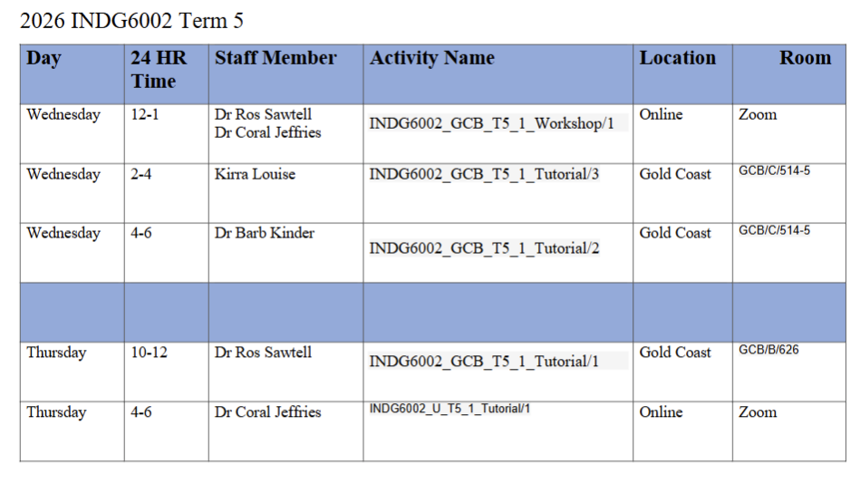
Delivery
This mode of learning may seem more intensive than you are used to, so it is important to keep up with the weekly modules. Students are expected to spend up to 20 hours per week progressing through the self-paced material and preparing for assessments, plus there is a one-hour workshop and several options of tutorial types and times to choose from.
The Workshop and online tutorials are recorded and will be available for those who cannot attend due to work commitments.
Face-to-Face Tutorials are not recorded

Slide 8
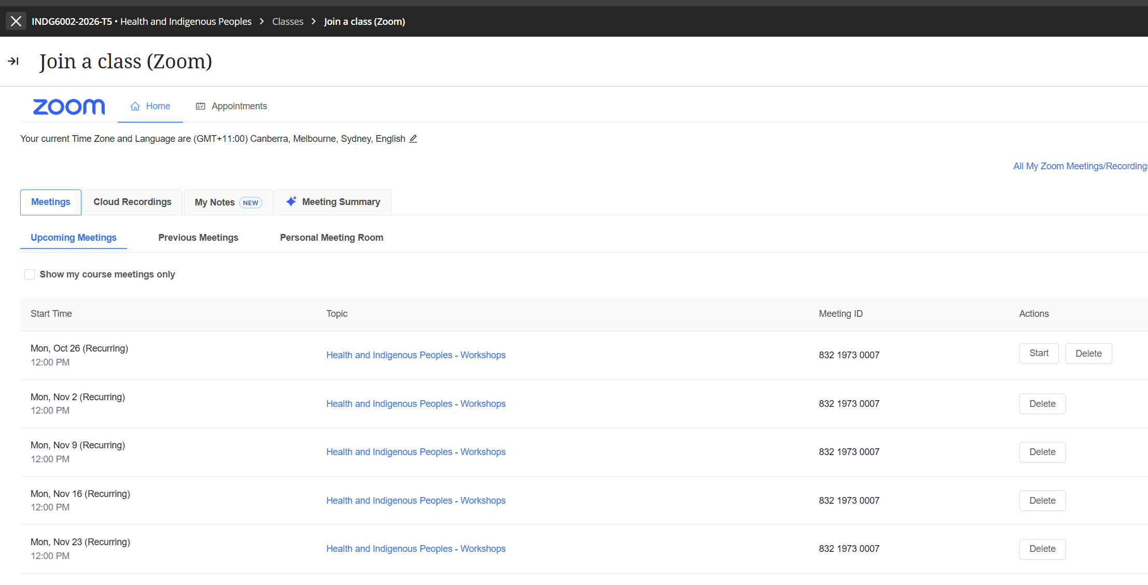
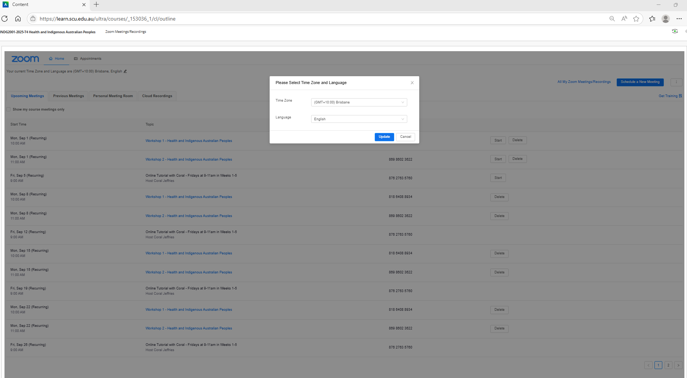
Zoom – Setting Correct Time

Slide 9
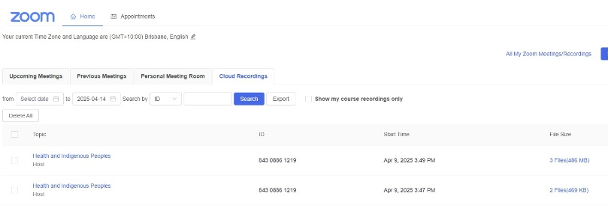
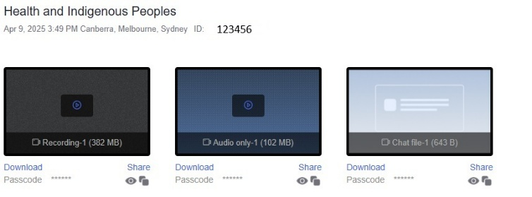
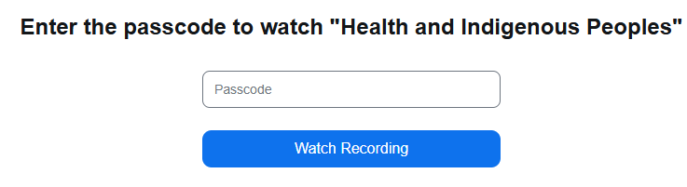
Zoom - Access to recordings
Select the ‘eye’ icon to display the Passcode
Copy this as you will need it on the next screen
The Recording (audio-visual) / Audio only recording will open

Slide 10
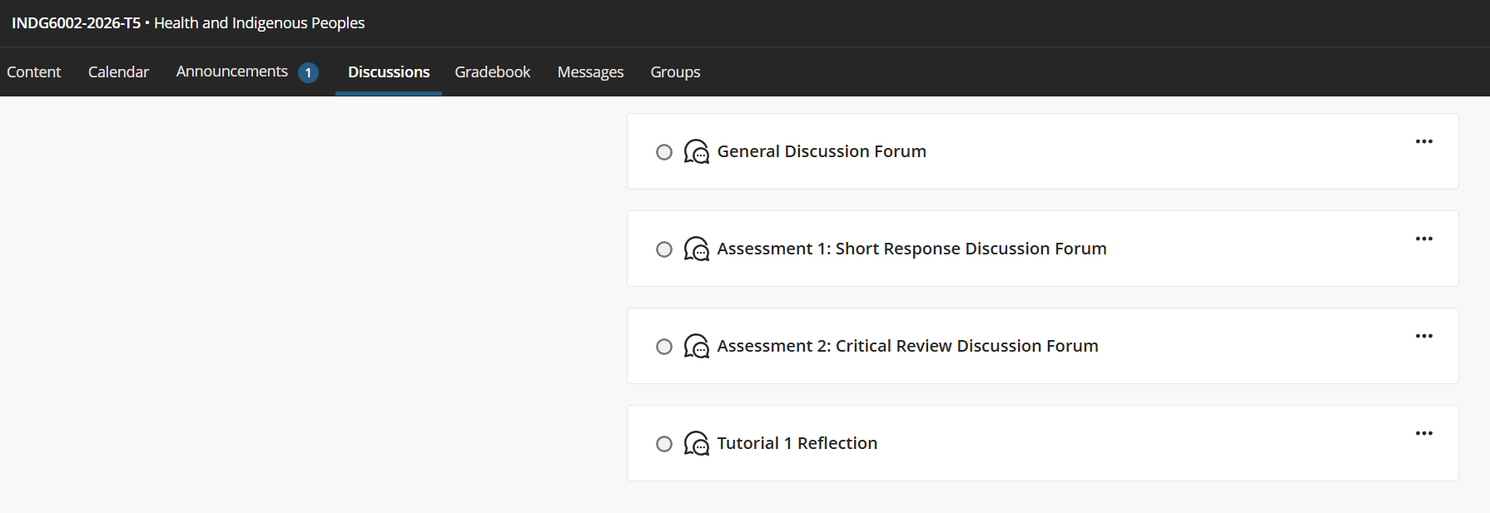
Discussion Forums

Slide 11
Indigenous Knowledges
Referencing
Guidance
at SCU
Provides guidance on how to respectfully assess, acknowledge, attribute, cite, and reference Indigenous Knowledges, with practical examples to support academic writing.
Latest version of the Indigenous Referencing Guidance for Indigenous Knowledges, now called the Indigenous Knowledges Attribution Toolkit (IKAT).
Both versions are accessed from the same embedded links on the Indigenous Knowledge (Gnibi) guides and the Indigenous Knowledge tab in SCU Library referencing guides.

Slide 12
Title | Assessment 1
Type | Short response
Length | 1,000 words
Weighting | 40%
Academic Integrity | Level 2. Purpose-Specific GenAI Use GenAI may NOT be used EXCEPT Grammarly Premium AI.
Submission | Word document submitted to Turnitin
Unit Learning Outcomes | This assessment task maps to the following ULOs: ULO1: Discuss key concepts of health and wellbeing as determined by Aboriginal and Torres Strait Islander Peoples. ULO2: Identify key stages of the colonisation process and its relationship to the contemporary health status of Indigenous Australian Peoples.
Assessment 1

Slide 13
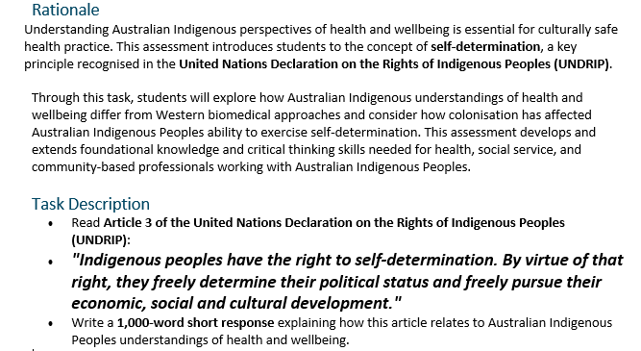
Assessment 1 Brief continued …

Slide 14
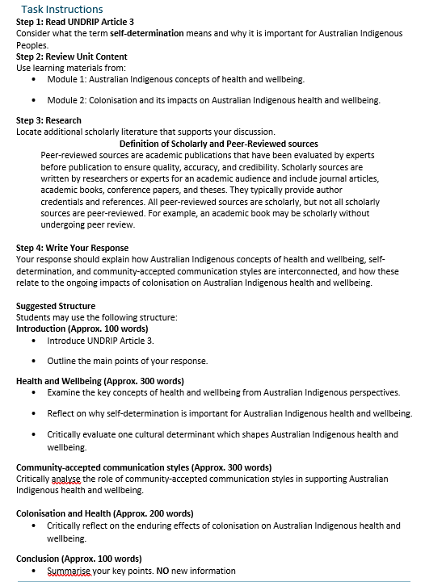
Assessment 1 Brief continued …

Slide 15
Guide to Writing a Short Response Structure
Always use unit approaches (concepts, theories, models, processes or guidelines) in your short responses. Often, this means defining and applying unit concepts or theories.
Before you start working on the assessment, find definitions in the unit materials. This step will help you gain a more detailed grasp of unit ideas and theories so that you can show this understanding to the marker.
Don't try to COVER EVERYTHING you know about a topic. While it can be tempting, this is not your task in a short response, and you don't have enough words. Offer your informed answer to the question within a limited word count.
As you brainstorm, plan, and draft keep trying to narrow, narrow, narrow your focus.

Slide 16
Short Response Structure
Start with a clear main point
1
Short responses must begin with the answer, not background. Use direct sentence starters such as: “Article 3 emphasises that…” “Self‑determination refers to…”
Explain the key concept briefly
2
Define or clarify the concept (e.g., self‑determination, holistic health, cultural determinants) in your own words before applying it. This prevents vague or incorrect use of terms.
Link the concept to UNDRIP Article 3
3
Show clearly how the concept relates to the rights described in Article 3 and to Australian Indigenous Peoples understandings of health and wellbeing. Interpret the connection—do not retell general background information.
Use scholarly or unit evidence
4
Short responses require academic grounding.
Write concisely and coherently Use short, direct sentences to improve clarity and reduce grammatical errors. Avoid long introductions, unnecessary detail, or narrative writing.
5
Maintain respectful terminology
6
Use correct and consistent terms such as Aboriginal and Torres Strait Islander Peoples. Avoid deficit language and ensure cultural safety.
Conclude by linking back to the question
7
End with a sentence that reinforces your main point and signals relevance to the marker. Do not introduce new information.
Avoid common pitfalls - Watch for: over‑description
missing the main point
weak or unclear links to Article 3
lack of evidence
8
Use postgraduate verbs
9
Choose verbs that show analysis and interpretation: analyse, interpret, examine, integrate, contextualise. Avoid vague verbs like talk about or discuss.
Follow a simple structure (PEEL)
10
Point → Explain → Evidence → Link
This keeps the paragraph focused, analytical, and academically grounded.

Slide 17
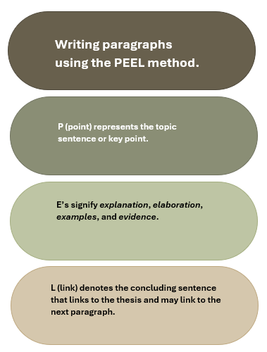
PEEL Writing Guide

Slide 18
Other Assessment Guidelines
Your assignment must be submitted as a Word document format
Line spacing should be either as per APA 7th Document formatting
Referencing style: APA 7th
Please state your name and subject type (SmithJ_ShortResponse), on the left margin in the footer, your Student ID in Centre of the footer, and display the page number on the right margin in the footer
The GenAI Declaration is in the Coversheet – this MUST be correctly completed and attached at the beginning of your assessment prior to final submission
All assignments are to be submitted online via the Turnitin assignment submission link contained in the relevant Assessment page under Assessment Tasks and Submission. You must label your submission with your surname and initials, and the assessment task's name, for example:
  SmithJ_ShortResponse.docx
Work submitted late without an approved extension will attract a penalty of 5 % for each day it is late. Approved extensions MUST be submitted using the Special Consideration for Support Form. This can be found:
Assessments / Assessment Information / Assessment support / Special Consideration Support
Word count includes the usual plus or minus 10% rule (Does not include Reference List or Coversheet/GenAI Declaration)

Slide 19
Referencing Guidelines
Ensure you meet the following Criteria:
Referencing style of APA 7th.
Consistent use of correct and appropriate terminology and tone in reference to Australian Indigenous Peoples, communities, and their priorities.
Use a minimum of 5 scholarly sources, You must also cite and reference UNDRIP. As UNDRIP is not a scholarly source, it does not count towards the minimum of five scholarly sources. Therefore, your reference list must contain at least six (6) references.
Wikipedia, Creative Spirits and or other such websites are not acceptable scholarly reference material.

Slide 20
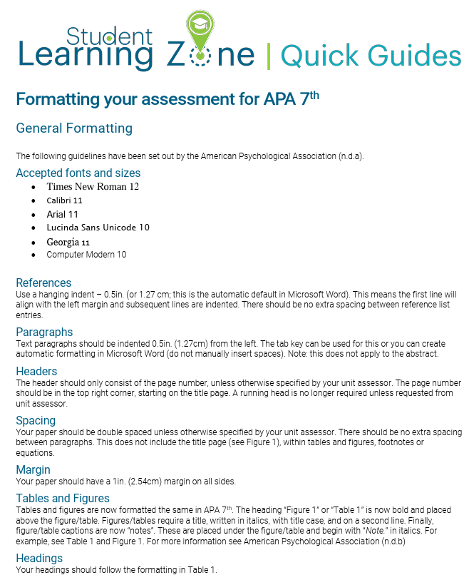
Document Formatting Guidelines

Slide 21

GNIBI GenAI use
In Gnibi College units, the use of GenAI in assessments is generally restricted to protect the integrity and authenticity of the learning process. Indigenous Knowledges are grounded in lived experience, cultural practices, and relational ways of knowing. Engaging meaningfully with these knowledges requires personal reflection, respectful interpretation, and a commitment to culturally responsive learning, something that cannot be authentically achieved through AI-generated content.
Generative Artificial Intelligence (GenAI) tools, such as ChatGPT, may not be used for this Assessment Task.
You must demonstrate that you have developed the required knowledge and skills independently, without the assistance of GenAI tools. Unauthorised use of GenAI may be considered a breach of academic integrity under the Student Academic and Non-Academic Misconduct Rules (Section 3).

Slide 22
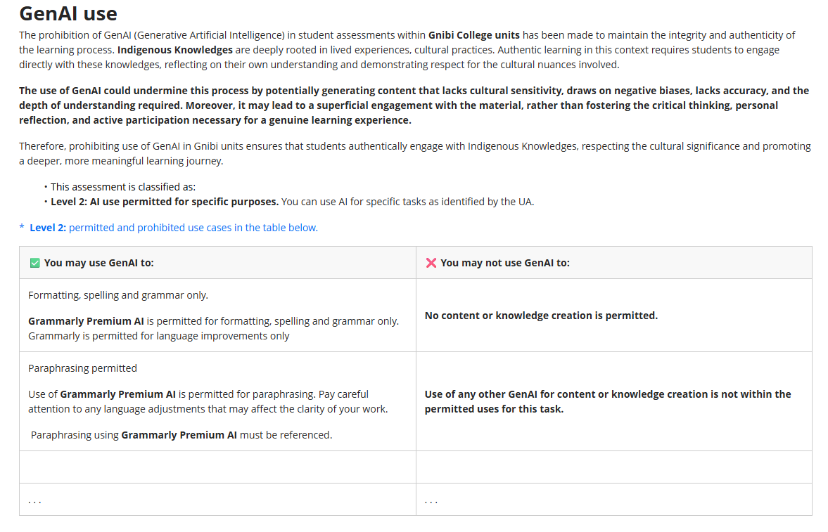
INDG6002 GenAI Use

Slide 23
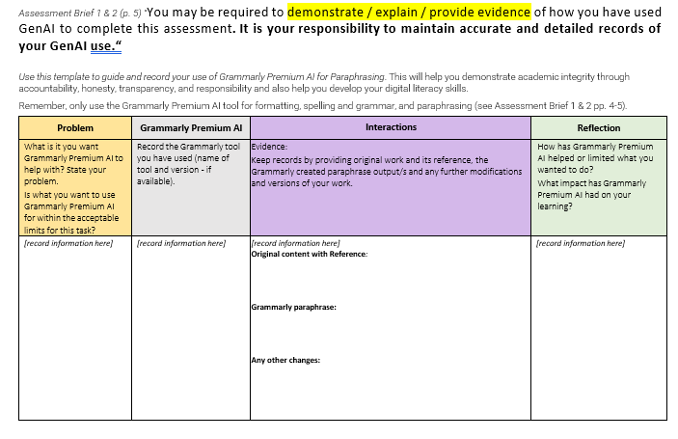
Grammarly Tracking Template

Slide 24
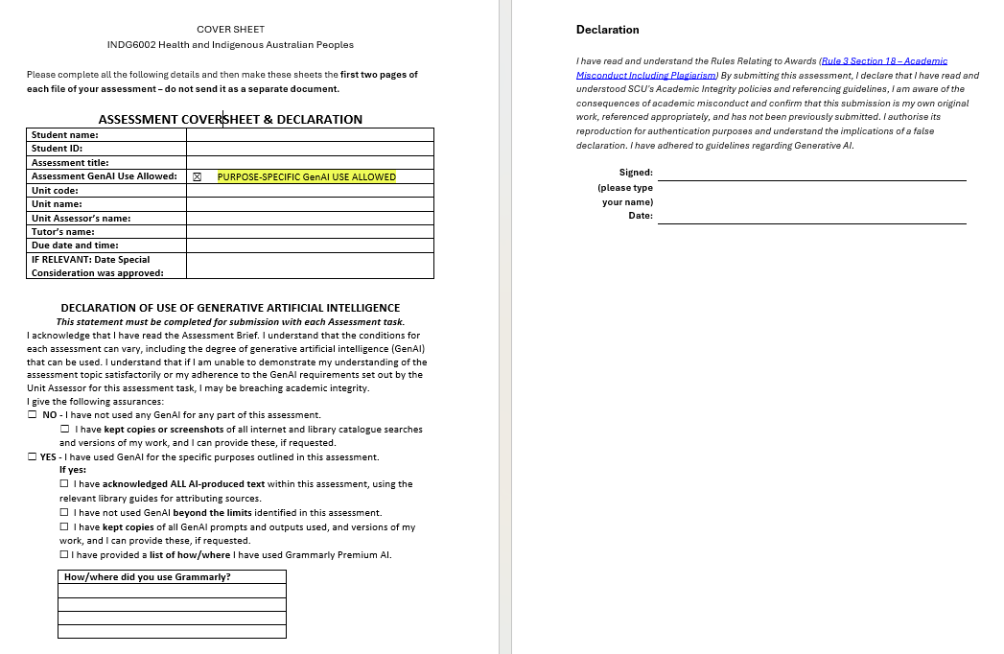
Assessment Coversheet & Declaration

Slide 25
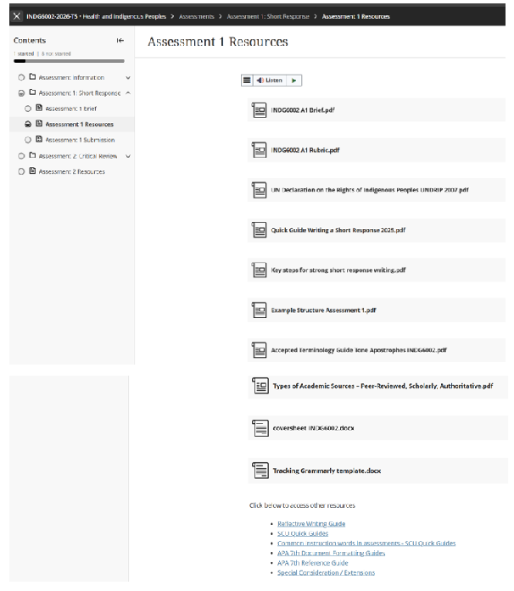
Assessment 1 Resources & Other Requirements

Slide 26
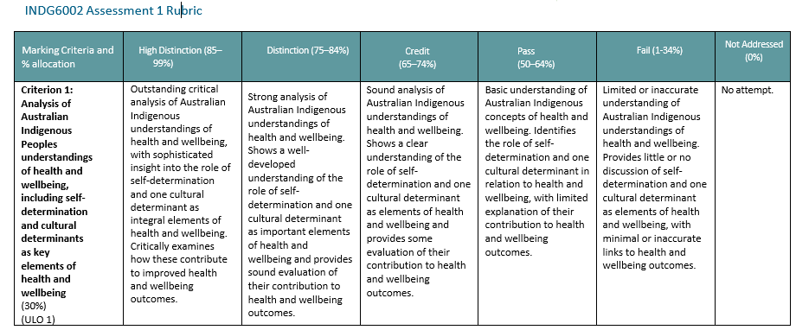
Assessment 1 Rubric – Criterion 1

Slide 27
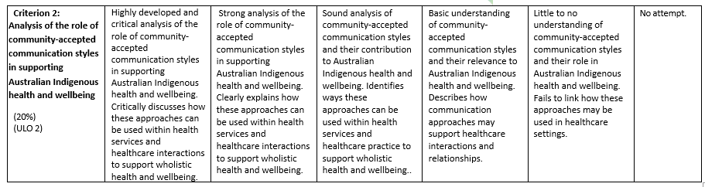
Assessment 1 Rubric – Criterion 2

Slide 28
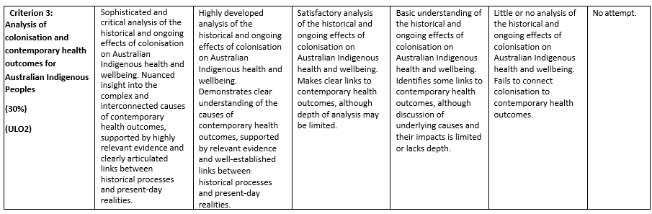
Assessment 1 Rubric – Criterion 3

Slide 29
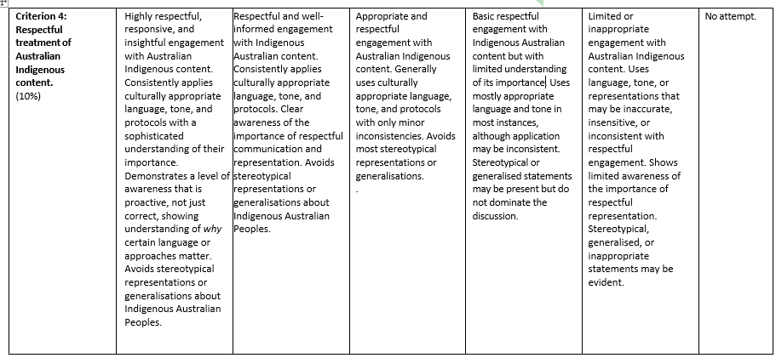
Assessment 1 Rubric – Criterion 4

Slide 30
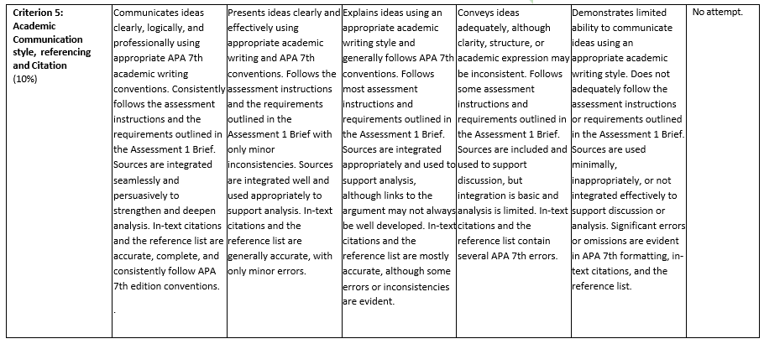
Assessment 1 Rubric – Criterion 5

Slide 31
Questions?

Slide 32
Until next time …

